Slide 1
Technology in Restaurants
Luke Jung

Slide 2
Current Status of Tech in Restaurants
There’s a big vacuum for tech in the Restaurant Scene
Traditional Methods of typical restaurant tasks are inefficient
Checking Temp Logs
Writing out bills
Losing orders
On-Demand Delivery continues to be a big market
Traditional Cash Registers still need better implementation
“Because of the fragmented nature of the industry and the very thin profit margins of most restaurants, the sector hasn’t evolved from a technology-innovation standpoint as quickly as other industries.” (The Globe)

Slide 3
Solutions to Inefficiencies in Restaurants Electronic Point of Sale (EPoS)
One of the biggest innovations are EPoS systems, that have been expanding through many restaurants.
Benefit of these Kiosks is that customers can order and pay all at one station, reducing need for workers and confusion.
Like self checkout at grocery stores, a mostly more efficient process with less frustration
Technology giving ability to watch food being prepared through webcams and pay bills all at once.

Slide 4
Touch Bistro: iPad POS for Restaurants
A specific POS that’s been popularized is Touch Bistro which has pretty good analytics.
Works where instead of having old fashioned orders on a paper, the iPad sends data directly to kitchen to get orders in.
This supposedly reduces wait time by “seven minutes a table.”
“Also ties 3rd party apps for accounting, inventory control, staff scheduling and management, reservations and online ordering” (The Globe)
Technology like this helps to increase data analytics and makes a seamless transition for customers and restaurant owners to make everything more efficient

Slide 5
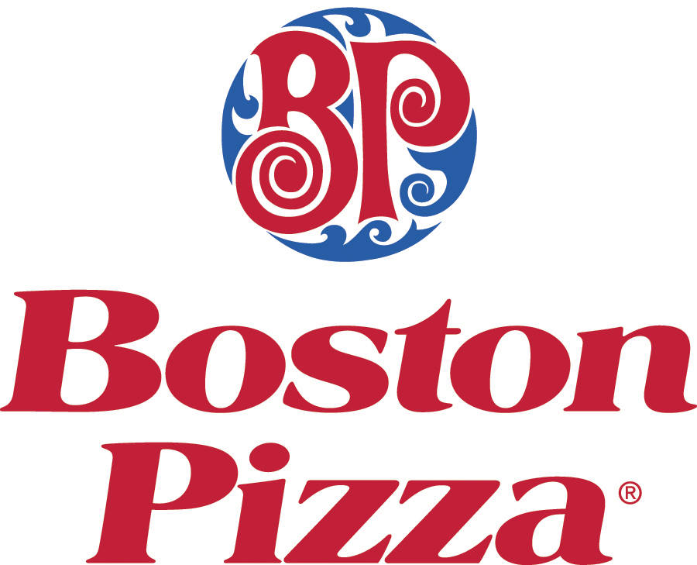
Boston Pizza International Inc.
Specific companies, such as Boston Pizza International, are switching to the use of progressive web apps to facilitate use of ordering and refill drinks
Boston Pizza is just one of many different chains and restaurants that are using technology to improve quality of life and clarity of serving food.
"With QSR Automations' technology, we are able to modernize both how our guests are able to interact with the Boston Pizza brand, as well as better enabling how our operators interact with their guests."

Slide 6
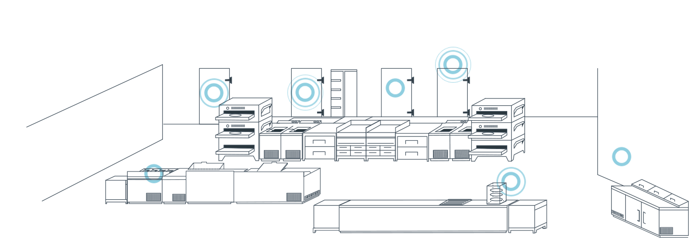
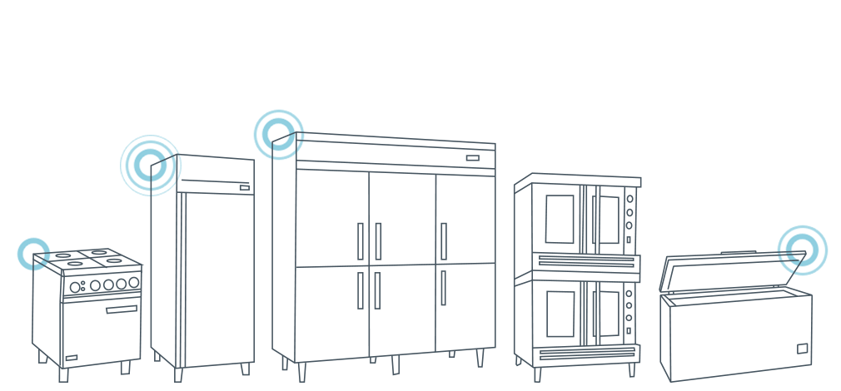
Blue Rover Inc
And more than even ordering and managing customers, technology for the backroom and storage has emerged as well.
Specific company, Blue Rover Inc helps to track temperatures of fridges and notifying through Bluetooth, as well as keeping them warmer using different modules.
Or different innovations for making sure delivery boxes are traveling to write place and removing the ability for human error.

Slide 7
Digital Inventory Tracking
Continuing with backroom technology, the ability to quickly track the inventory of storage has been heavily improved in the past few years.
The ability to project expected stock levels based on data helps owners see how they’re doing in terms of business.
The programs can “alert managers to discrepancies from over-portioning, waste, and theft so that they can be resolved immediately.” (Fast Casual)
Programs have been built to automatically order more products when inventory goes below a certain threshold.

Slide 8
Digital Table/Reservation Manager
Different companies have also created easily accessible applications to check wait times and how many people are ahead of them
One major company that does this is Yelp which records the people in line and gives an estimated wait time as well as text message reminders.

Slide 9
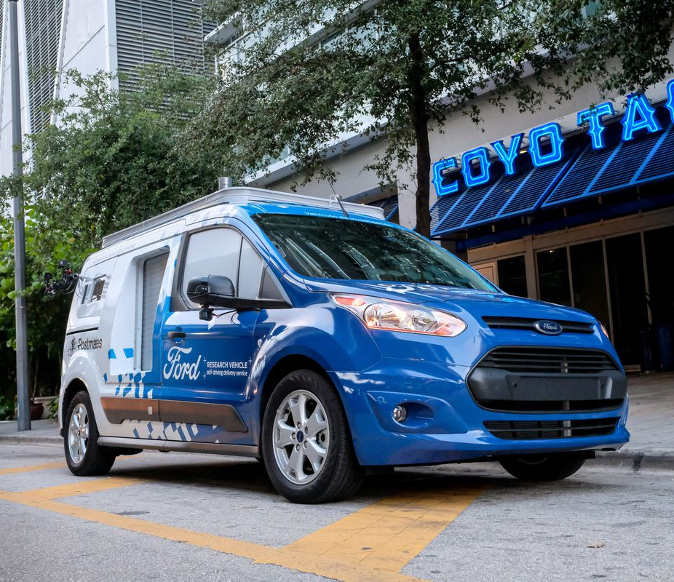
Autonomous Drivers
With the advent of services like Uber eats, post mates, and other delivery services, the ability to obtain food has become so much easier.
Yet as self driving cars become more better developed, which is sure to happen in the next decade, these services will be even more ubiquitous.
Ford has begun to roll out with these vans to serve their customers, predicting ”eventually, the automaker says it will deploy a fully self-driving delivery service by 2021.” (TheVerge)
The advent of a connected world means faster delivery times in a world where everything is literally at the touch of your fingers.

Slide 10
Face Recognition
A restaurant called Cali Burger has also implemented facial recognition to recognize loyal customers and pull up their past transactions to reduce transaction times.
The end-goal of face recognition is to hopefully implement credit cards to process transactions even quicker.
While Cali Burger is one of the first restaurants to utilize this technology, it might also be one of the first for a while since it is very uncommon.

Slide 11
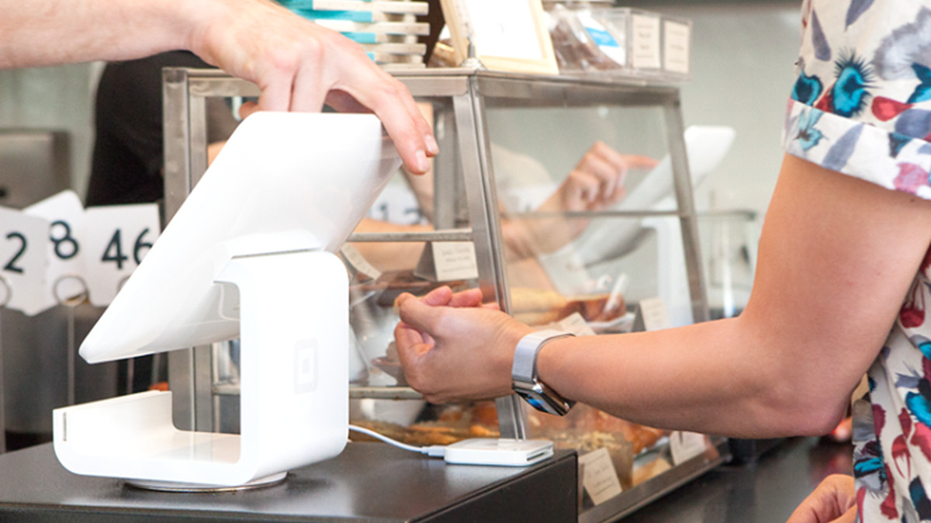
Possible Concerns
While the technology has grown and has made so many more things efficient there also exists the idea that these innovations take away from the hospitality aspect of restaurants.
People want to have servers that treat them well and demonstrate warmth, kindness, and hospitality.
Cashless payments discriminates against PoC since many of them don’t have the means to have a debit/credit card to pay for things.
The inability to use cash and keep anonymity worries others from having to give too much of their personal information.

Slide 12
Final Thoughts and Future Hopes
While some of the concerns of the new technology may be valid, the technology ultimately helps both customers and business owners more.
With new technology, we can increase revenue, decrease time, and overall make the whole dining experience better.
Due to this the realm of technology in restaurants continues to have so much more room to grow.
Some future hopes include having a bigger and more widespread implementation of these different services to make technology not a luxury, but a staple in restaurant life.

Slide 13
References
Bayern, Macy. “How Tech Has Revolutionized Restaurant Hospitality.” TechRepublic, 4 Dec. 2018, www.techrepublic.com/article/how-tech-has-revolutionized-restaurant-hospitality/.
Creamer, Dorothy. “Restaurant of the Future.” Hospitality Technology, 9 Aug. 2016, hospitalitytech.com/restaurant-future.
Hawkins, Andrew J. “Ford's ‘Self-Driving’ Vans Are Now Delivering Food in Miami.” The Verge, The Verge, 11 June 2018, www.theverge.com/2018/6/11/17448702/ford-self-driving-car-food-delivery-miami-postmates.
Johne, Marjo. “Technology, Slow to the Restaurant Scene, Is Now on the Menu.” The Globe and Mail, The Globe and Mail, 2 Nov. 2018, www.theglobeandmail.com/business/article-technology-slow-to-the-restaurant-scene-is-now-on-the-menu/.
Keane, Niall. “7 Technologies Transforming the Restaurant Industry.” Www.fastcasual.com, 9 Jan. 2018, www.fastcasual.com/articles/7-technologies-transforming-the-restaurant-industry/.
Sietsema, Robert. “Opinion: Square Is the Most Annoying Thing to Happen to NYC Dining in Years.” Eater NY, Eater NY, 30 Aug. 2018, ny.eater.com/2018/8/30/17764042/square-rant-robert-sietsema.
Wirth, Sara Rush. “7 Predictions for What Lies Ahead for Tech in Restaurants.” Restaurant Business, Restaurant Business, 1 Jan. 2018, www.restaurantbusinessonline.com/technology/7-predictions-what-lies-ahead-tech-restaurants#page=1.
Wirth, Sara Rush. “Burger Chain Tests Facial Recognition for Ordering and Loyalty.” Restaurant Business, Restaurant Business, 20 Dec. 2017, www.restaurantbusinessonline.com/technology/burger-chain-tests-facial-recognition-ordering-loyalty.

